Slide 1

IPL case study
A research project by Hithesh BP

Slide 2
Case study
This case study consists of 2 tables.
The first table named “Matches” consists of details of all the matches from 2008-2019.
The second table named “Deliveries” consists of ball to ball details of these matches.
In this case study, I will be solving some questions and the results will be presented graphically.

Slide 3
objectives
Analyse the performances of the teams and the players.
Plot the results in the graph to make understanding easy.

Slide 4
findings
Teams
Season with most number of matches
Team with most number of wins
Player with most number of player of match awards
Number of matches in each venue
Champions each season
Toss decision percentage
Top run scorers
Highest number of 6’s, 4’s by a batsman

Slide 5
Teams
Sunrisers Hyderabad
Mumbai Indians
Gujarat Lions
Rising Pune Supergiant
Royal Challengers Bangalore
Kolkata Knight Riders
Delhi Daredevils
Kings XI Punjab
Chennai Super Kings
Rajasthan Royals
Deccan Chargers
Kochi Tuskers Kerala
Pune Warriors
Rising Pune Supergiants
Delhi Capitals

Slide 6
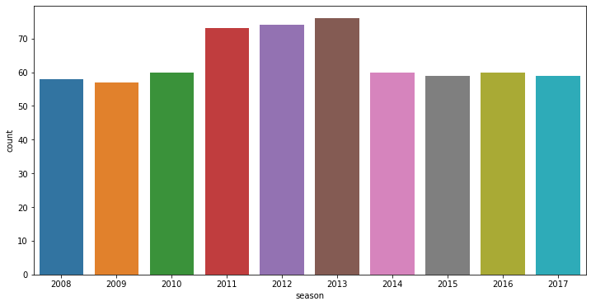
Season with most number of matches
2013 season had the most number of matches(76 matches) following with 2012.

Slide 7
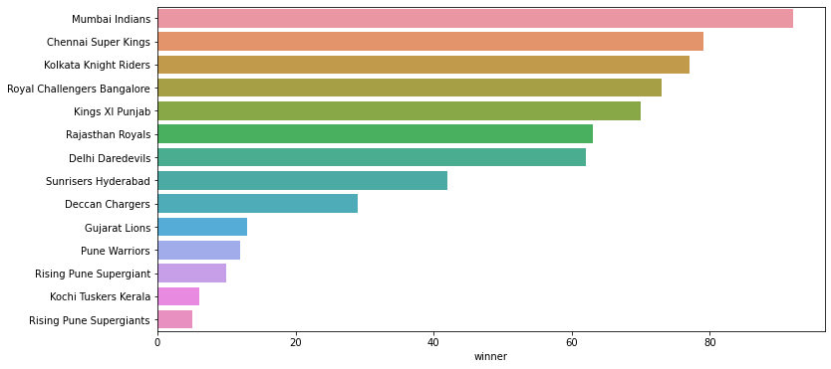
Team with most number of wins
Mumbai Indians are the winners in most of the matches

Slide 8
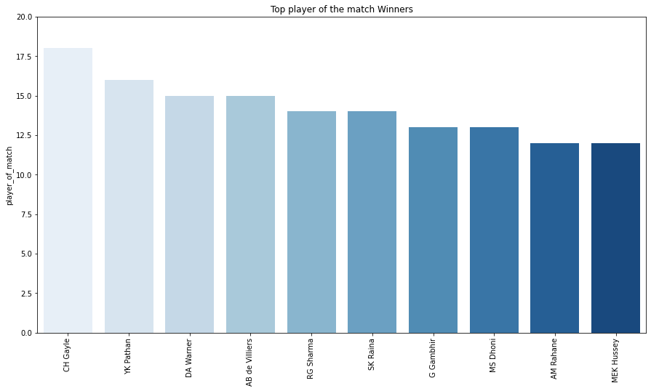
Player with most number of player of match awards
CH Gayle is the most Successful player in all match winners

Slide 9
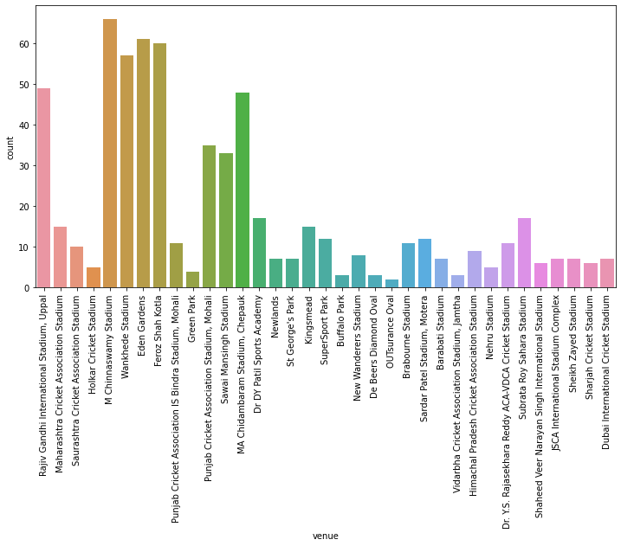
Number of matches in each venue
M Chinnaswamy stadium has the most number of matches played

Slide 10
Champions each season
2008 - Rajasthan Royals
2009 - Deccan Chargers
2010 - Chennai Super Kings
2011 - Chennai Super Kings
2012 - Kolkata Knight Riders
2013 - Mumbai Indians
2014 - Kolkata Knight Riders
2015 - Mumbai Indians
2016 - Sunrisers Hyderabad
2017 - Mumbai Indians
2018 - Chennai Super Kings
2019 - Mumbai Indians

Slide 11
Toss decision percentage
Almost 62% of the toss decisions are made to field first.

Slide 12
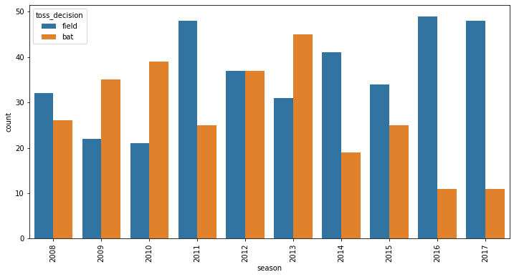
Toss decision varied over time
Decision of batting first has been gradually decreased over the years.

Slide 13
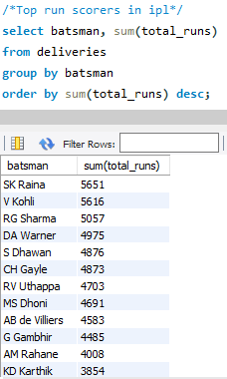
Top run scorers
Suresh Raina is the highest run scorer followed by Virat Kohli.

Slide 14
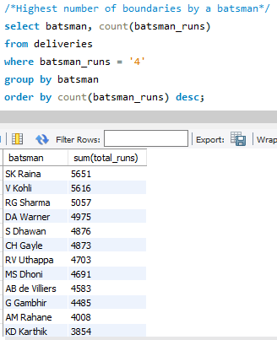
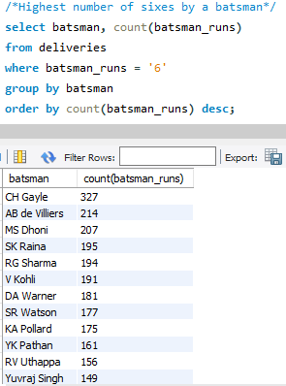
Highest number of 6’s, 4’s by a batsman
Suresh Raina again has the highest number of boundaries followed by Virat Kohli.
CH Gayle has hit the highest number of sixes in IPL

Slide 15
Thank you

